Slide 1
A1 Chemistry
ionic bonding

Slide 2
Review
Valence determines the bonding arrangement. Metals have relatively high mp and bp, high density, good thermal and electrical conductivity, lustre, malleability and ductility as a result of the densely packed lattice of positive ions surrounded by a sea of delocalised electrons.

Slide 3
Explain why metals are good thermal and electrical conductors. A diagram may be useful. (6 marks)

Slide 4
Learning intention
ionic bonding can be modelled as a regular arrangement of positively and negatively charged ions in a crystalline lattice with electrostatic forces of attraction between oppositely charged ions
the ionic bonding model can be used to explain the properties of ionic compounds, including high melting point, brittleness and non-conductivity in the solid state; the ability of ionic compounds to conduct electricity when molten or in aqueous solution can be explained by the breaking of the bonds in the lattice to give mobile ions

Slide 5
Success criteria
Draw a diagram to show the arrangement of particles in ionic bonding
List the properties of ionic compounds
Relate each property of ionic compounds to their bonding arrangement

Slide 6
key words
ions
crystalline lattice
brittle (ness)
molten
mobile

Slide 7
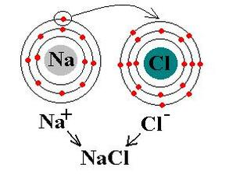
ions
Ions form when atoms with low electronegativity (relatively empty shells) bond with atoms with high electronegativity (relatively full shells), resulting in a transfer of electrons.
ion.
Atoms which lose electrons become positively charged, while those that gain electrons become negatively charged. Outer shells in both atoms are now full and tightly held.

Slide 8
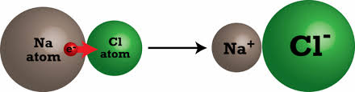
IONIC BONDING
Positive ions are very strongly attracted to negative ions, but are repelled by each other.
This results in a solid crystalline lattice of alternating positive and negative ions which are strongly held in place but with moderately large spaces between them.

Slide 9
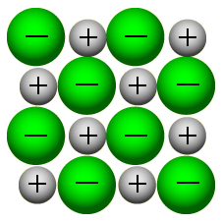
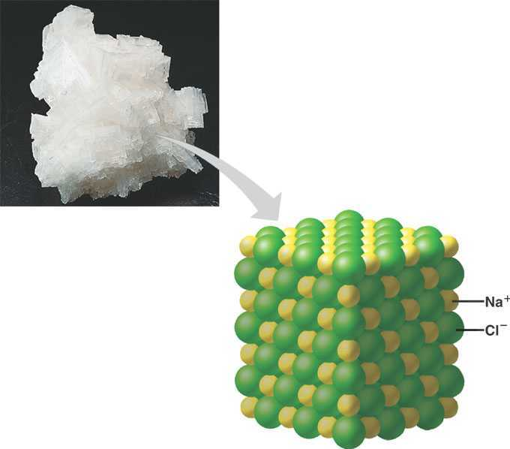

Slide 10
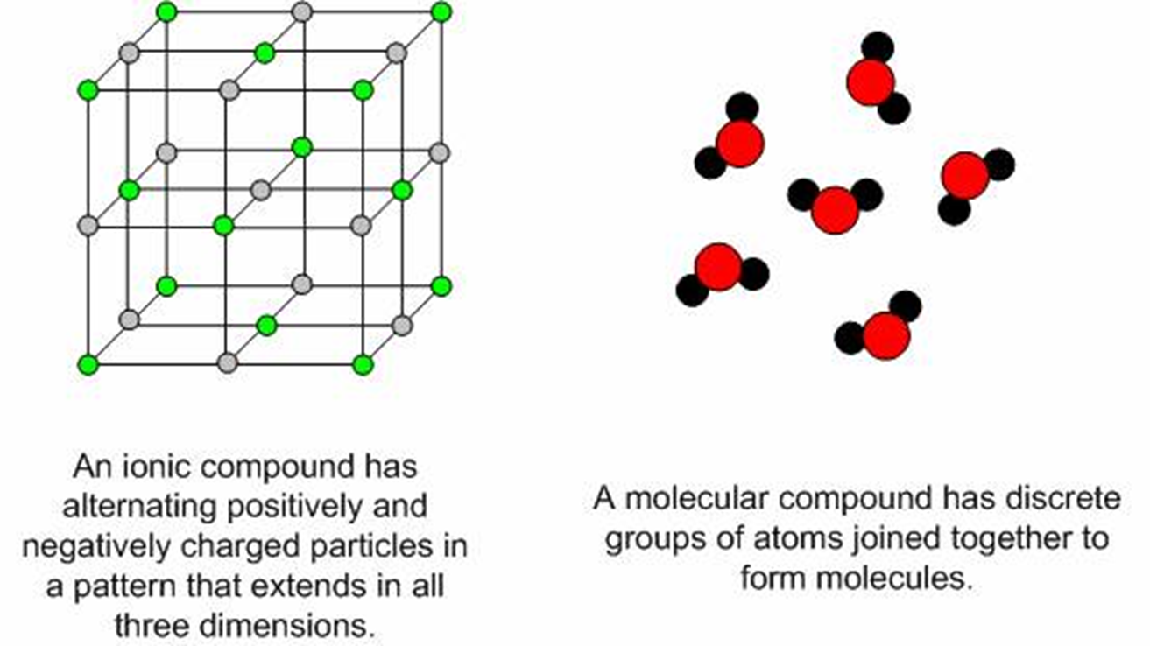
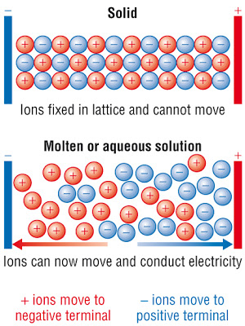
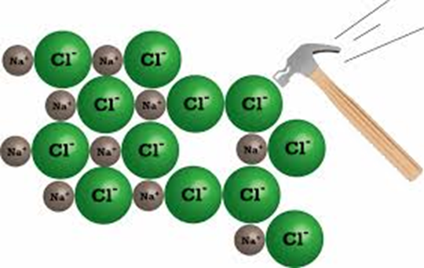
ionic compounds
have high melting and boiling points
have relatively low density
are hard but brittle
are poor thermal conductors
are electrical insulators in solid states
are good electrical conductors in molten or aqueous states

Slide 11
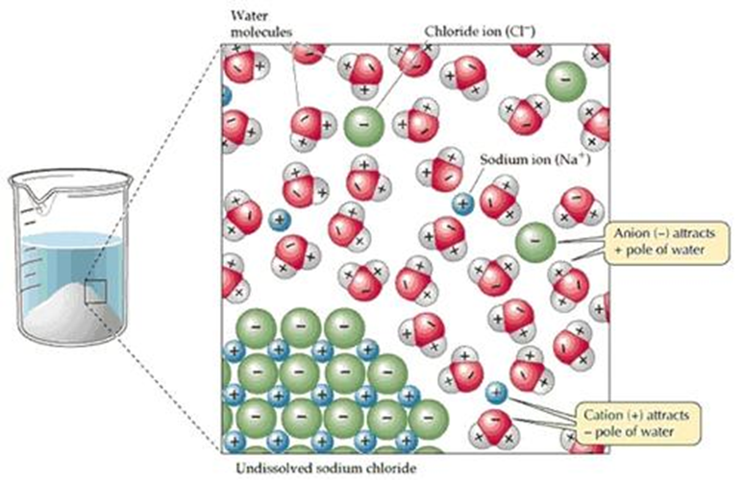

Slide 12
Success criteria
Draw a diagram to show the arrangement of particles in ionic bonding
List the properties of ionic compounds
Relate each property of ionic compounds to their bonding arrangement

